Slide 1


Optimizing Group Success: A Mathematical Approach to Team Formation
Presented by
Sandhya kamireddy
Hitaishi Bairapureddy
Neetu Aavula

Slide 2
Introduction
Objective: To assign 12 students into 4 balanced groups of 3, maximizing their collective potential. Success is determined using a calculated score based on key factors: teamwork, GPA, and role-handling abilities, all optimized through a mathematical framework.

Slide 3
Choice of Factors: We chose three key factors for group success:
Teamwork (30%): Prioritized for its critical role in collaboration and group dynamics.
GPA (50%): Reflects academic strength, scaled for precision.
Role Distribution (20%): Highlights the ability to manage responsibilities effectively.
The weights balance teamwork, academic ability, and role efficiency to form well-rounded groups.

Slide 4
Data Collection
To simulate a realistic scenario, data for the three factors was randomly generated:
Teamwork scores were assigned random values between 1 and 10, reflecting varying levels of collaboration skills among students.
GPA scores were scaled between 0 and 50 to capture academic performance with greater detail.
Role Distribution scores were also randomized between 1 and 10 to account for diverse role-handling abilities.
This approach ensures a diverse dataset, avoiding any real-world biases while enabling meaningful analysis.

Slide 5
Formulation: The problem was modeled as a mathematical optimization problem:
Objective Function: Maximize the total success score for all groups:
Success Score=0.5⋅Teamwork+0.3⋅GPA+0.2⋅Role Distribution
This ensures groups are formed to maximize their potential.
Decision Variables: Binary variables (xij) indicate whether student i is assigned to group j.
Constraints:
Each student is assigned to exactly one group.
Each group must consist of exactly 3 students.
This approach guarantees balanced and successful group formation.

Slide 6
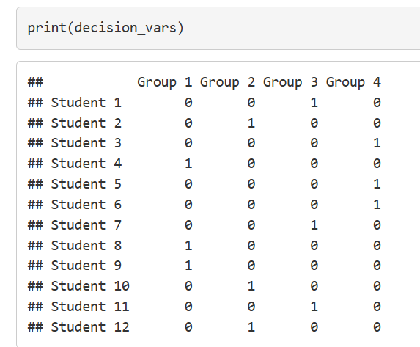
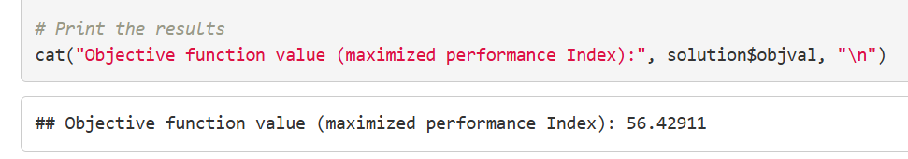
RESULTS
Decision Variables
Objective Function

Slide 7
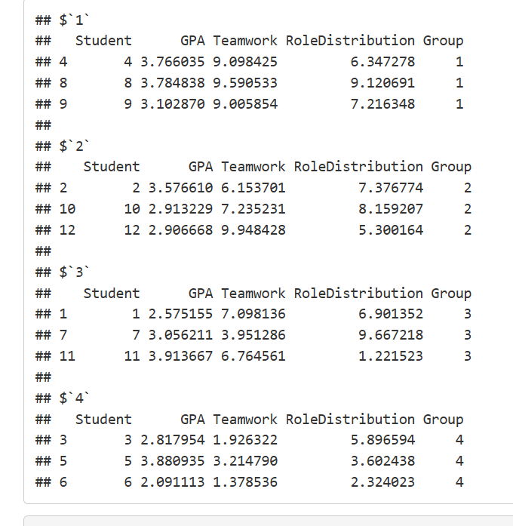
Group Wise Insights

Slide 8
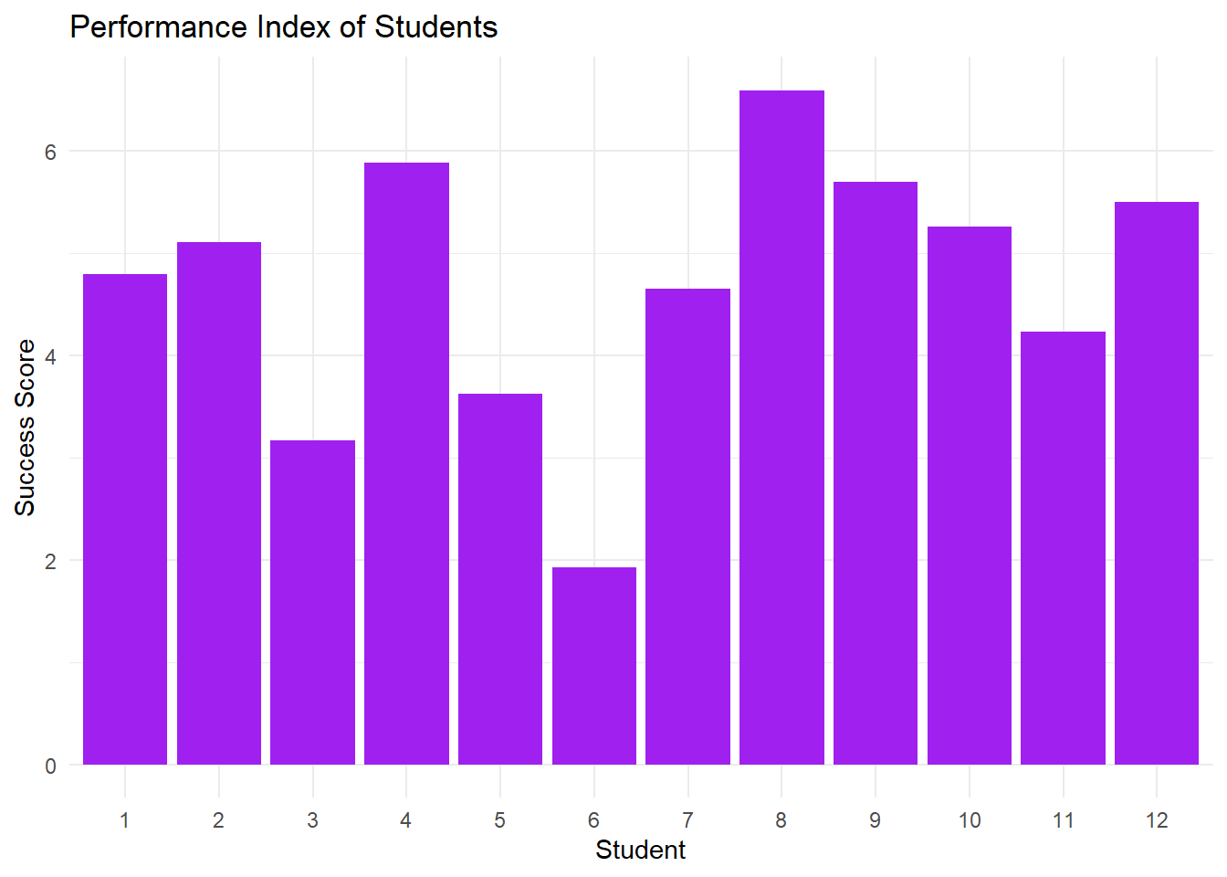
Bar Plot for Performance Index of Students
Bar B
The graph shows variability in student performance, with Student 8 achieving the highest success score and Student 6 the lowest. Most students score between 4 and 6, indicating a moderate level of success. The data highlights both top performers and areas where improvement is needed.

Slide 9
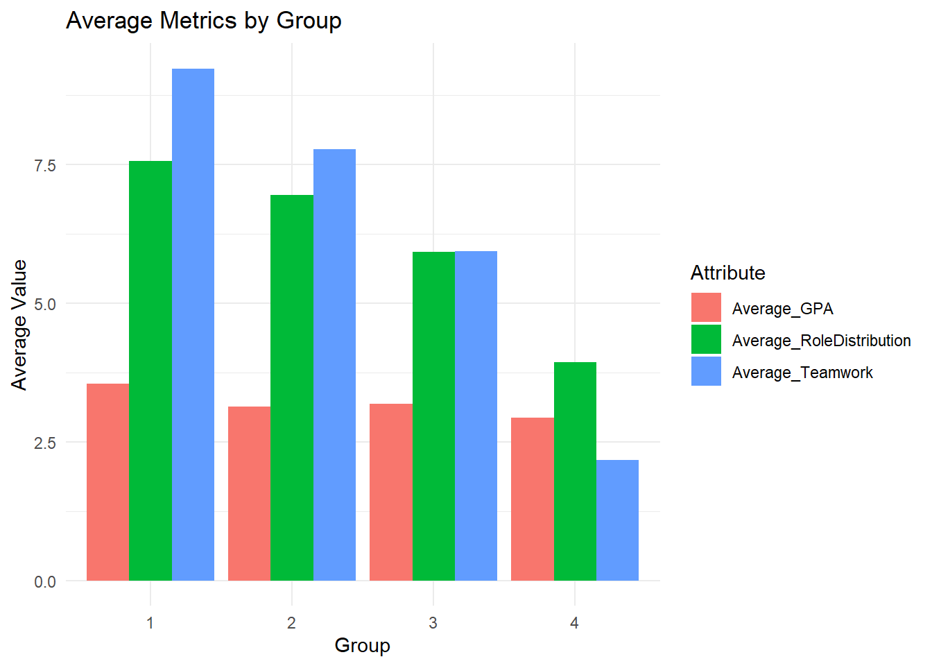
Group-wise average GPA, Teamwork, and Role Distribution
Group 1 stands out with the highest teamwork scores, indicating strong collaboration within the group. Role Distribution is consistently higher than GPA in all groups, reflecting a better balance in task allocation compared to academic performance. Group 3 and Group 4 show relatively lower averages in teamwork, with Group 4 displaying the most balanced but overall lower scores across all metrics. GPA remains the lowest metric in all groups, suggesting it is the area with the most room for improvement. Overall, Group 1 demonstrates the strongest performance, particularly in teamwork and role distribution.

Slide 10
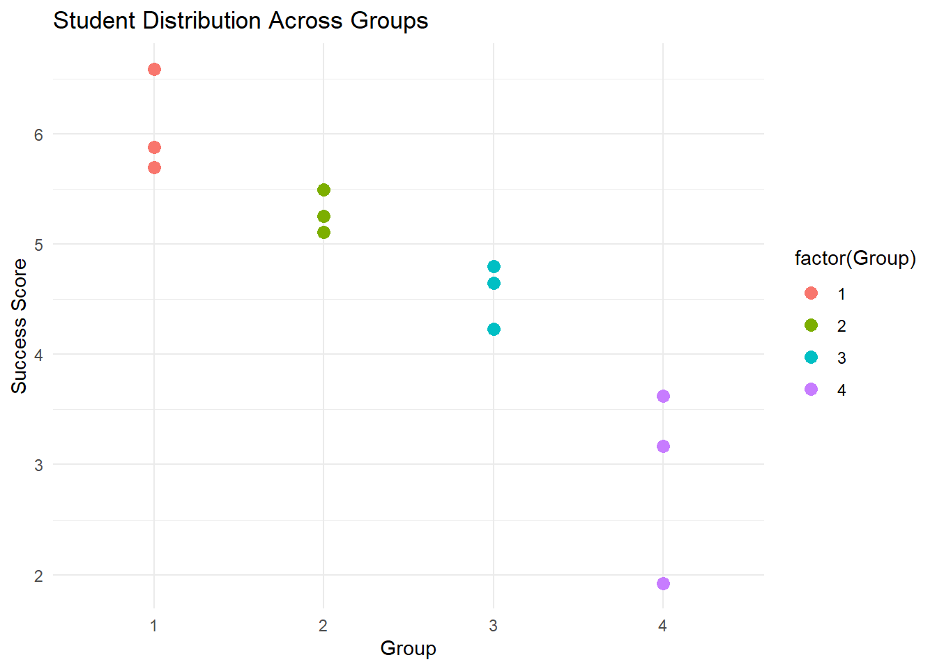
Scatter Plot of Student Distribution across Groups
Bar B
Group 1 stands out with the highest scores, as all students score above 6, indicating strong performance. Groups 2 and 3 have similar distributions, with most scores clustered around 5, reflecting moderate success levels. In contrast, Group 4 exhibits the lowest performance, with success scores ranging between 3 and 4. Overall, the plot reveals a clear hierarchy in group performance, with Group 1 leading and Group 4 lagging significantly behind.

Slide 11
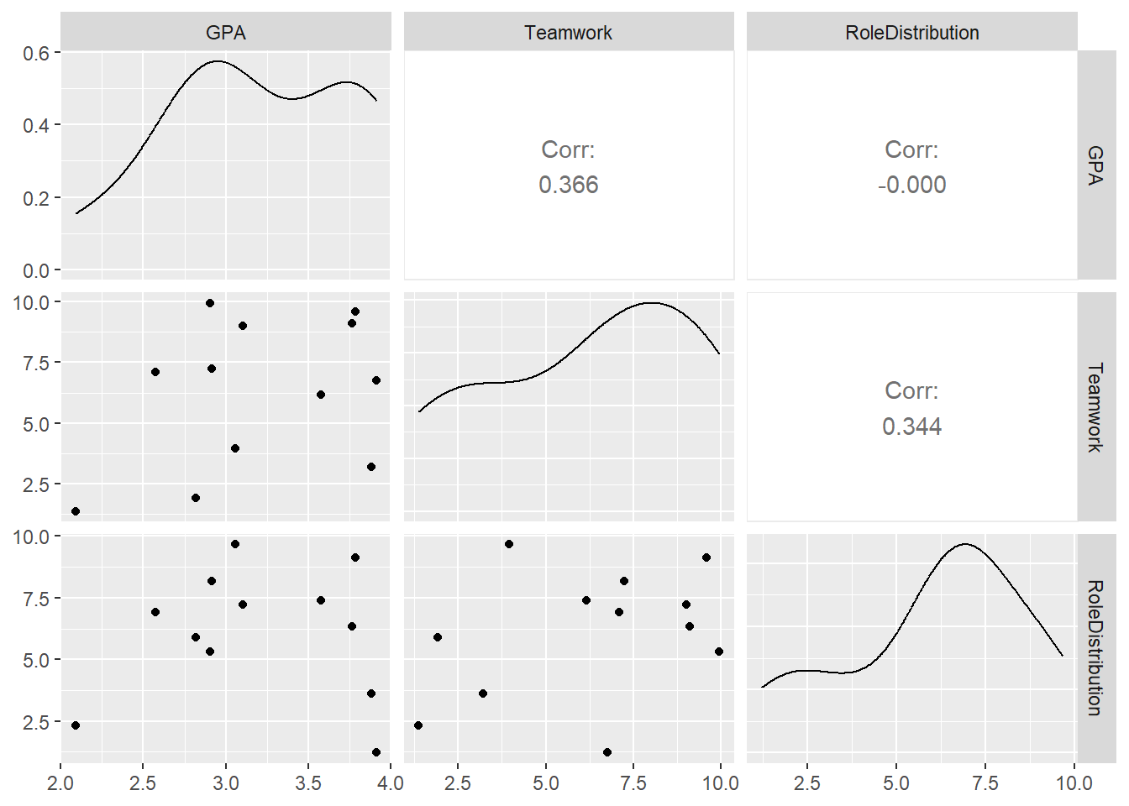
Pairs Plot of the Factors
Bar B
The scatterplot matrix reveals a moderate positive correlation between GPA and Teamwork (Corr: 0.366, 0.344). However, there is no significant correlation between Role Distribution and either GPA or Teamwork (Corr: -0.000). The distribution of all three variables appears right-skewed based on the density plots

Slide 12
Conclusion
The optimization of group assignments demonstrates a deliberate approach to balancing teamwork, academic performance, and role distribution, yielding an objective function value of 56.42911. The analysis underscores the pivotal role of teamwork (40% weight), supported by GPA (30%) and role distribution (20%), in maximizing group success. Group 1 emerged as the strongest performer, excelling in teamwork and role distribution, while Group 4 faced challenges, achieving the lowest scores across all metrics.

Slide 13
CONCLUSION(cont..)-
Insights from visual analyses reveal significant variability in student performance and group dynamics. The scatter plot and bar graph emphasize that Group 1's cohesive teamwork significantly boosts success, whereas Groups 3 and 4 show the need for strategic interventions to enhance collaboration and task allocation. Notably, GPA consistently lags across all groups, highlighting it as an area requiring focus for academic improvement.
The scatterplot matrix further validates a moderate correlation between GPA and teamwork, indicating that collaboration can potentially drive academic outcomes. However, the lack of correlation between role distribution and other factors suggests that role management, though critical, does not inherently align with academic or teamwork metrics.

Slide 14




Thank you

